Slide 1

YUNFILLIPS MONTESSORI
SCHOOLS
SPONSORSHIP

Slide 2

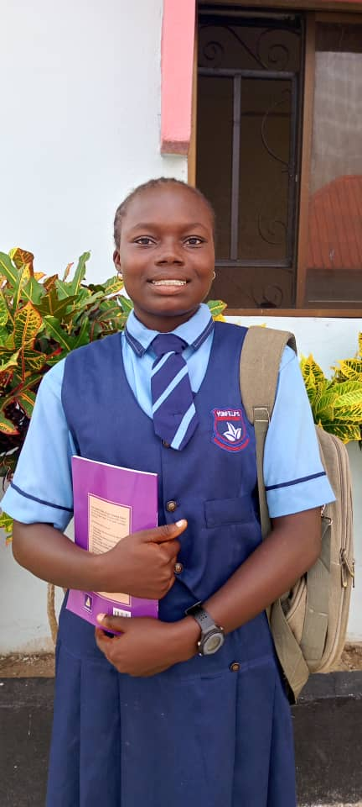
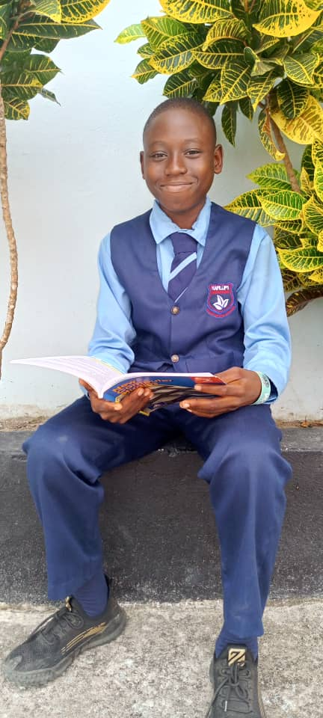
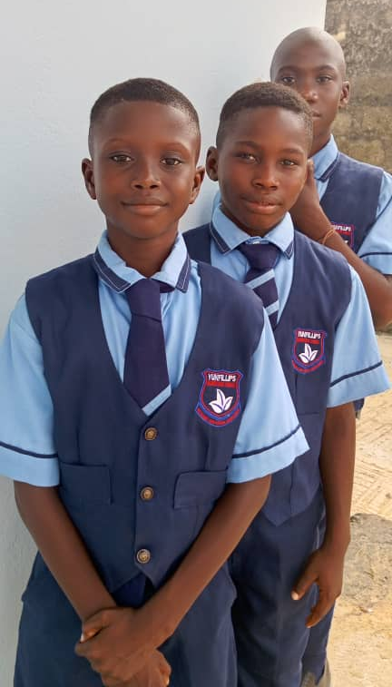
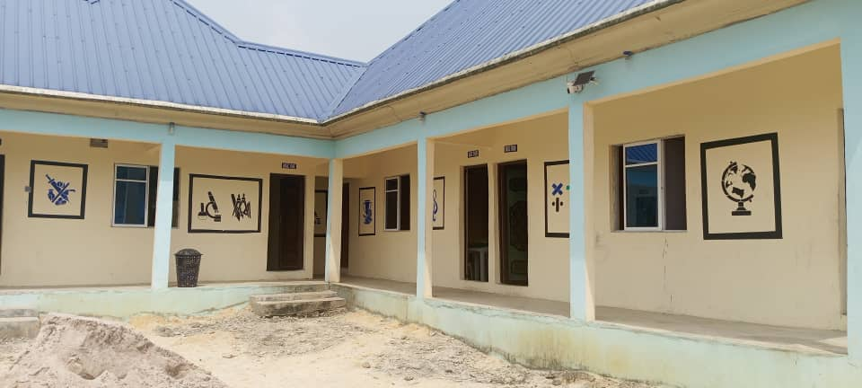

Slide 3

ABOUT
YUNFILLIPS MONTESSORI SCHOOLS
Vision: To nurture and produce world-class leaders.
‎Mission: Deliver an exceptional educational experience that prioritises academic excellence and the personal growth of every student.
‎‎Core Value: Academic and Moral Excellence.

Slide 4
ABOUT
YUNFILLIPS MONTESSORI SCHOOLS
At our school, our ethos is firmly rooted in Christian faith, strong moral values, and academic excellence. We believe that every child is created with purpose and potential, and we are committed to nurturing each learner in a God-fearing, loving, and disciplined environment.
Guided by Christian faith, we place great emphasis on character formation, integrity, respect, and service, alongside high academic standards. Our approach to education develops the whole child—mind, character, and spirit—equipping pupils with the knowledge, confidence, and values needed to thrive in an ever-changing world.
Through dedicated teaching, prayerful guidance, and positive partnerships with parents, we seek to raise children who are not only academically sound, but also morally upright, compassionate, and responsible citizens, prepared to lead and make meaningful contributions to society.

Slide 5
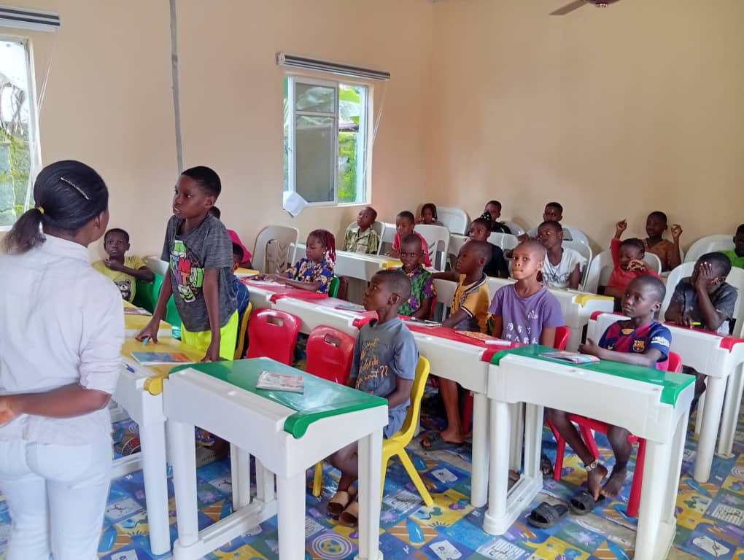
PURPOSE OF THE
SCHOLARSHIP SCHEME
This scholarship scheme is designed to empower children from poor and educationally deprived families to ensure they have access to quality education.

Slide 6
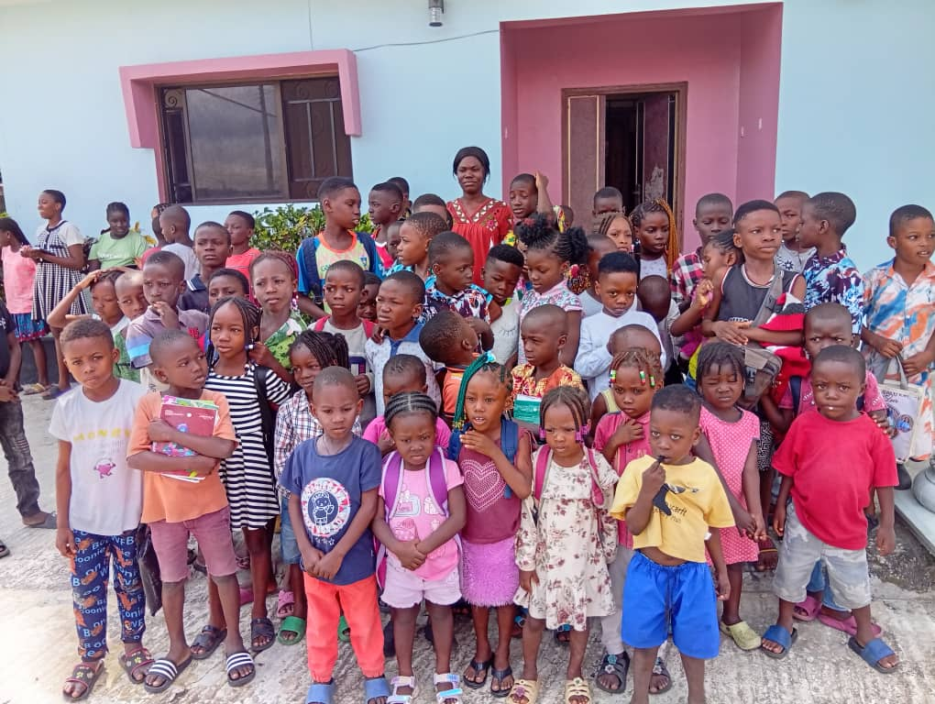
ABOUT ALADJA COMMUNITY
Aladja community, a once economically vibrant community housing the renowned Delta Steel company has been plagued by communal war since 1996. Families face economic hardship, unemployment, and unstable living conditions, making quality education beyond reach for many families.

Slide 7
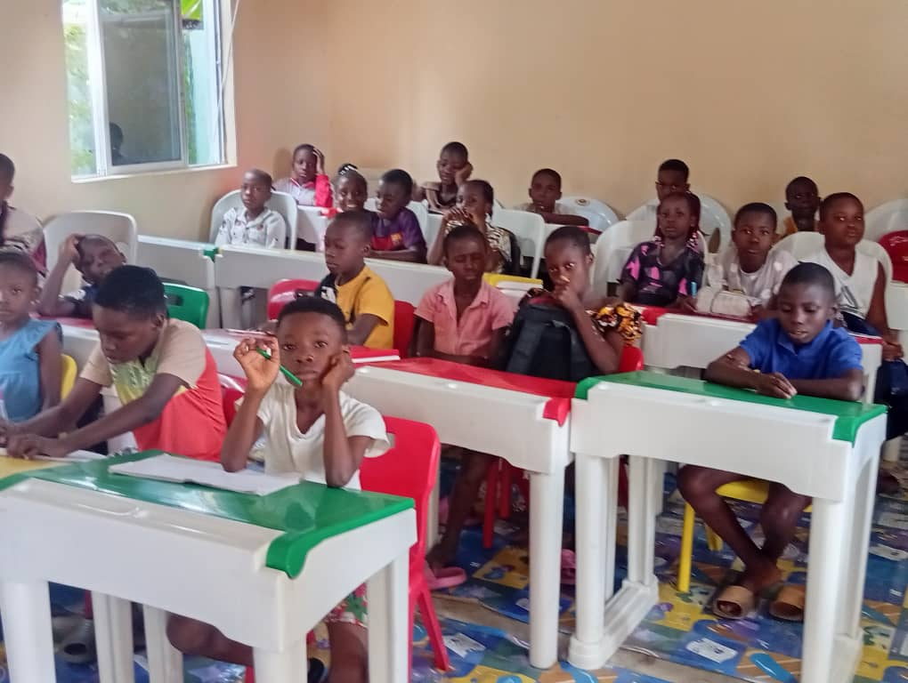
The Children We Are Supporting / Their Reality Today
These children are full of curiosity and potential, yet many lack basic learning materials, uniforms, and consistent schooling. Without support, their dreams are limited by circumstances beyond their control. Through this sponsorship, each child will have a chance to grow academically, socially, and emotionally, and see a future full of possibilities.

Slide 8
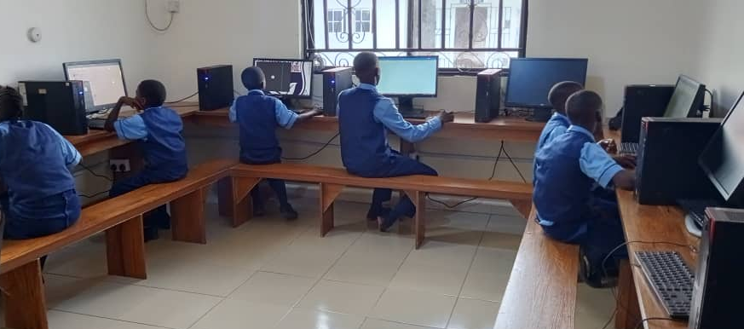
Why Your Support Matters
Your sponsorship is more than funding, it is hope, stability, and opportunity.
‎Through your financial support, children can attend school with dignity, access learning materials, and pursue their dreams.

Slide 9
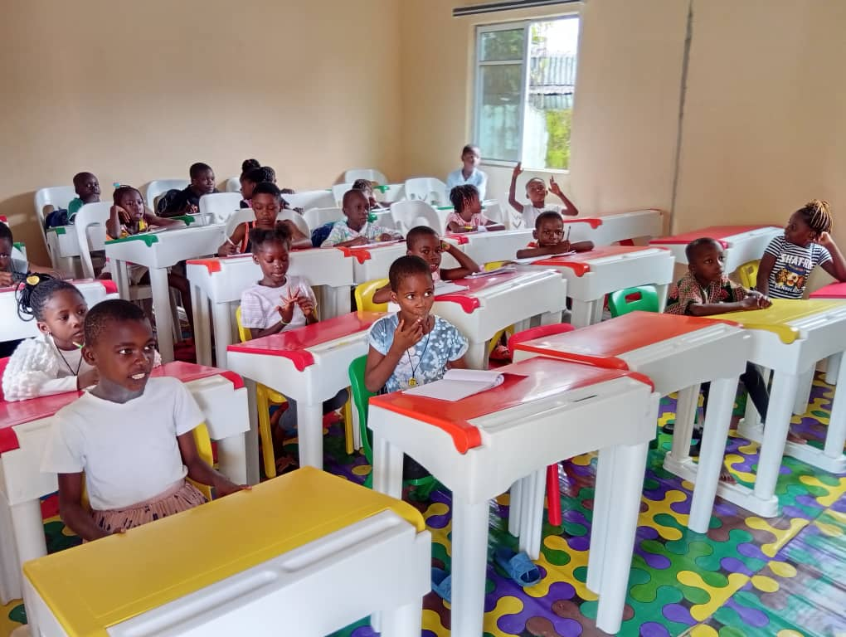
OUR GOAL
To support a minimum of 100 children, providing them with a full range of educational opportunities at Yunfillips Montessori Schools. With your help, these children will have the chance to thrive academically, socially, and emotionally.

Slide 10
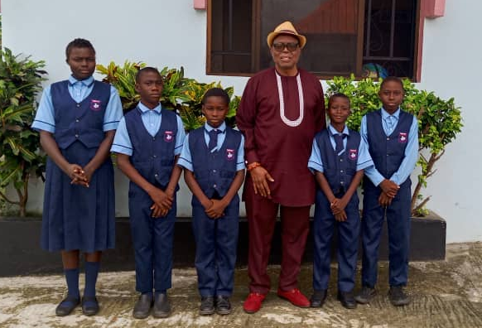
PAYMENT CATEGORYAND PLAN
Flexible options are available for every sponsor:
‎Monthly Sponsorship
‎Quarterly Sponsorship
‎Annual Sponsorship
KINDERGARTEN
Yearly Sponsorship total (1ST, 2ND & 3RD TERM) KG #253K Approximately £133
PRIMARY
YEARLY SPONSORSHIP TOTAL (1^{ST,} 2ND & 3RD TERM) Primary #322k Approximately £170
SECONDARY
YEARLY SPONSORSHIP TOTAL (1ST, 2ND, & 3RD TERM) Secondary #365K Approximately £192

Slide 11
PAYMENT DETAILS
YUNFILLIPS CREATION LIMITED
UNION BANK
0234151247
OR
Account name: ERUENAH YA
Sort Code: 60-60-05
Account Number: 45877947
BIC: NWBKGB2L
IBAN: GB85NWBK60600545877947

Slide 12
CONTACT
Young Eruenah (EHT) +447818274682
Rev Mrs Edesiri Eruenah (Director) +447891717257
Mrs Chioma Fregene (HT) +2349034371223
Yunfillipsmontessorrischools@gmail.com
www.yunfillips.com
Address: Ekreghware / Iyeghe Quarters,
Off College Road, Aladja, Udu LGA, Delta State.

Slide 13
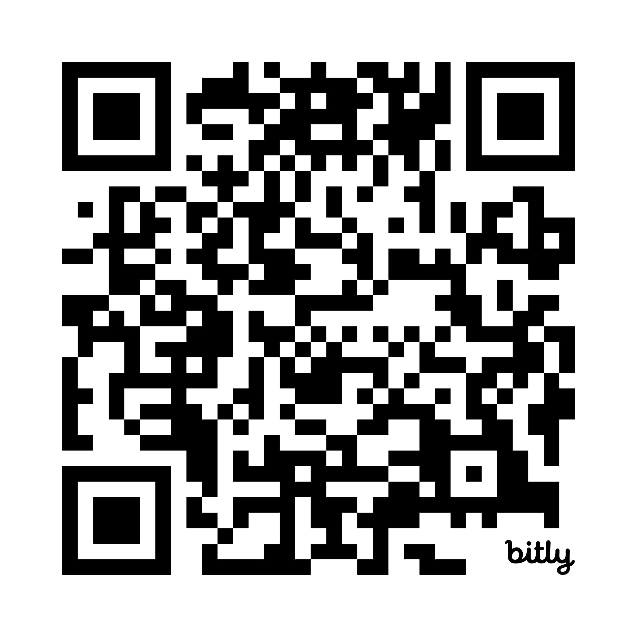
WEBSITE QR

Slide 14
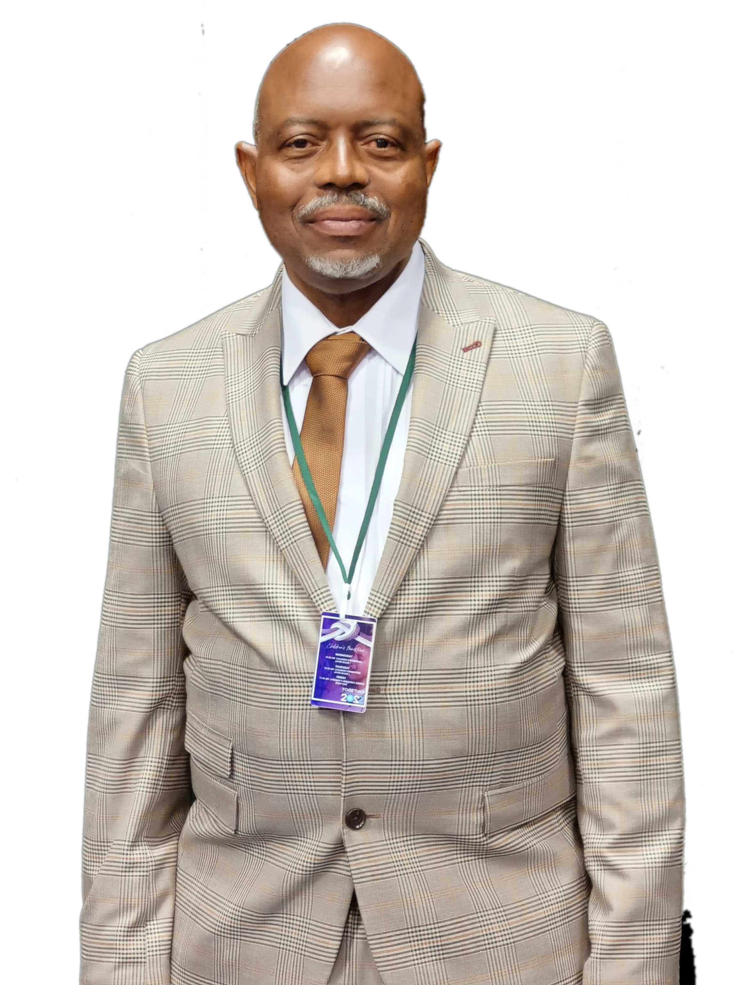
SPONSORSHIP
Dear Esteemed Brothers and Sisters, Please, help us to support the listed children from poor and educationally deprived families in the Sponsorship Program.
God bless you In Jesus Name, Amen.
Young Eruenah
Executive Headteacher,
Yunfillips Montessori Schools.

Slide 15
THANK
YOU

